Slide 1
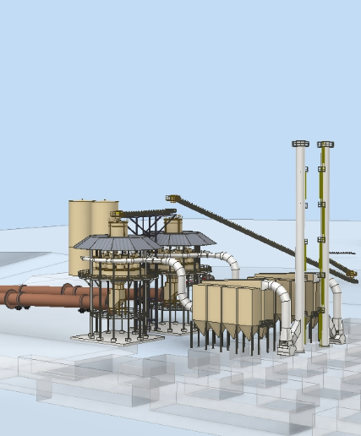
LIMESTONE PROJECT – SYNERGY
(Monon, Indiana)
Project: Synergy Management
New Two Line Production Plant
Monon, Indiana
Projects J14140 & J14141
Scope: Removal of two kilns @ Midlothian
Concrete & foundation design
Kiln pier & kiln installation
Preheater installation
Cooler installation
Start-up support
Project Equipment:
Two kilns (relocated from Texas)
Preheater tower & ducts
Cooler
Option to install other equipment
(baghouses, burner bldg., etc)

Slide 2
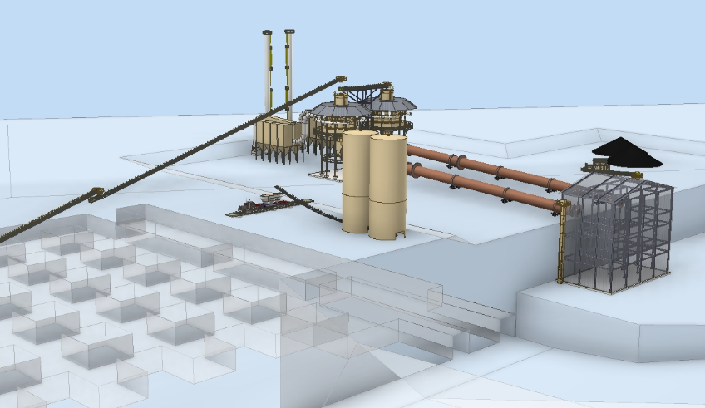
LIMESTONE PROJECT – SYNERGY
(Monon, Indiana)
New Plant 3D Model – Synergy, Monon, Indiana

Slide 3
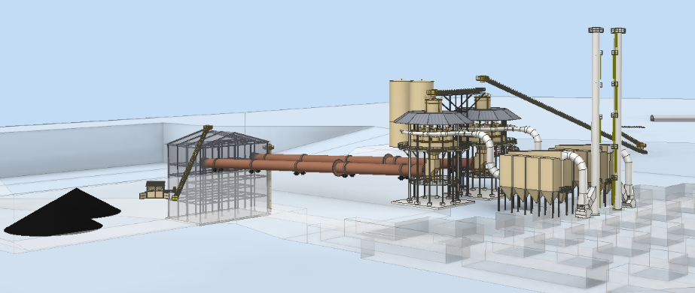
LIMESTONE PROJECT – SYNERGY
(Monon, Indiana)
New Plant 3D Model – Synergy, Monon, Indiana

Slide 4
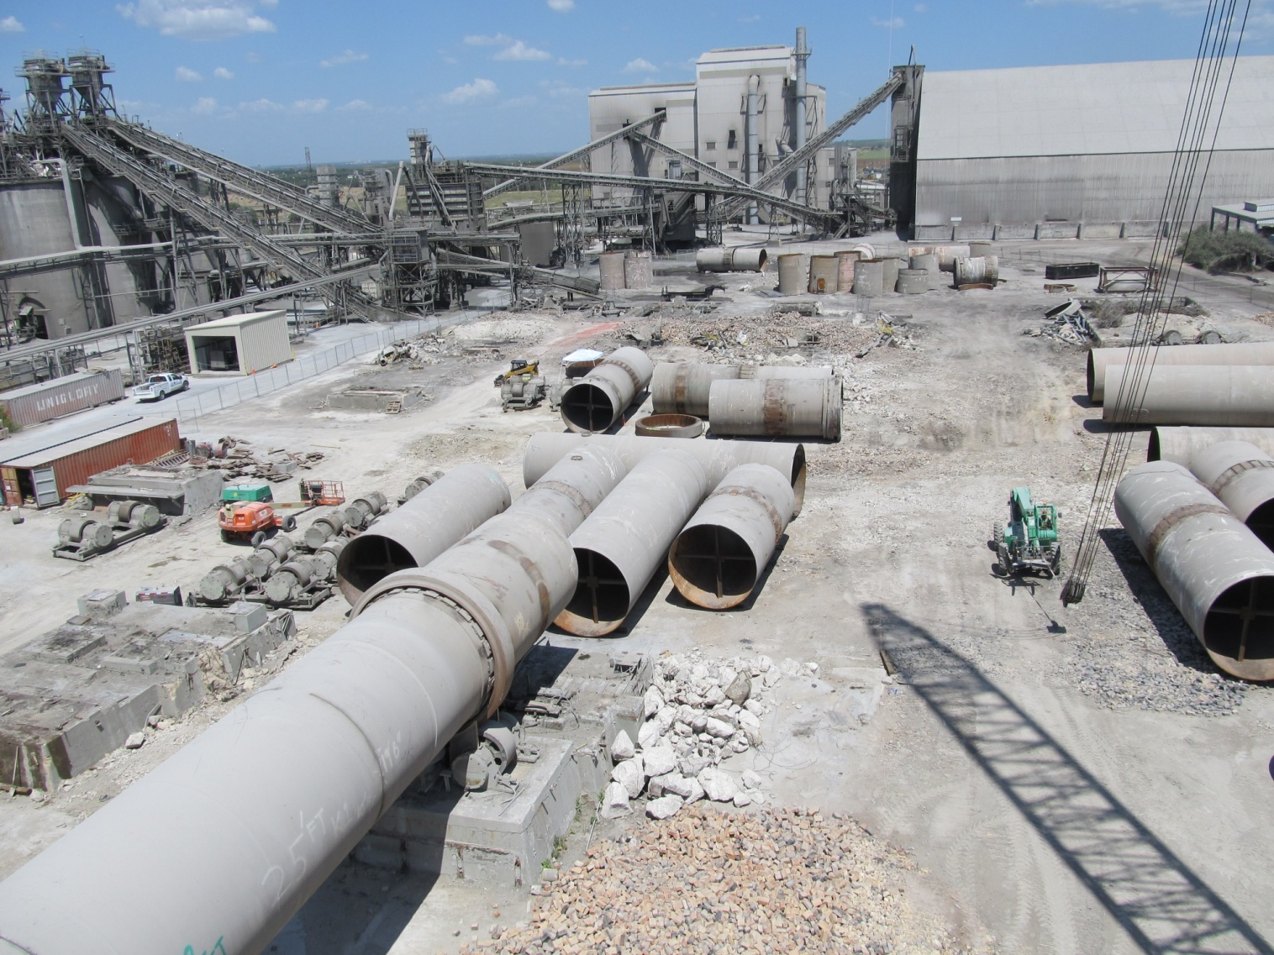
KILN REMOVAL – SYNERGY
(Midlothian, Texas)
Kiln Removal – Midlothian, Texas (@ TXI’s cement plant)

Slide 5
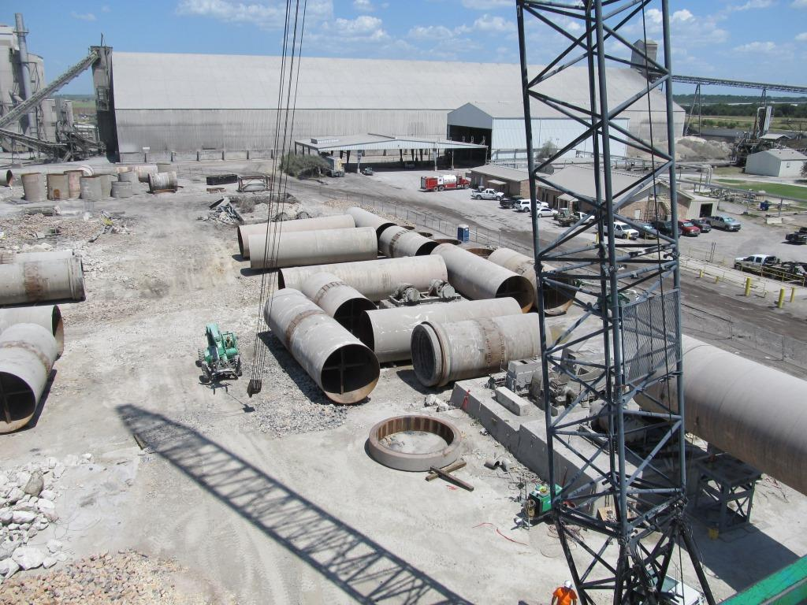
KILN REMOVAL – SYNERGY
(Midlothian, Texas)
Kiln Removal – Midlothian, Texas (@ TXI’s cement plant)

Slide 6
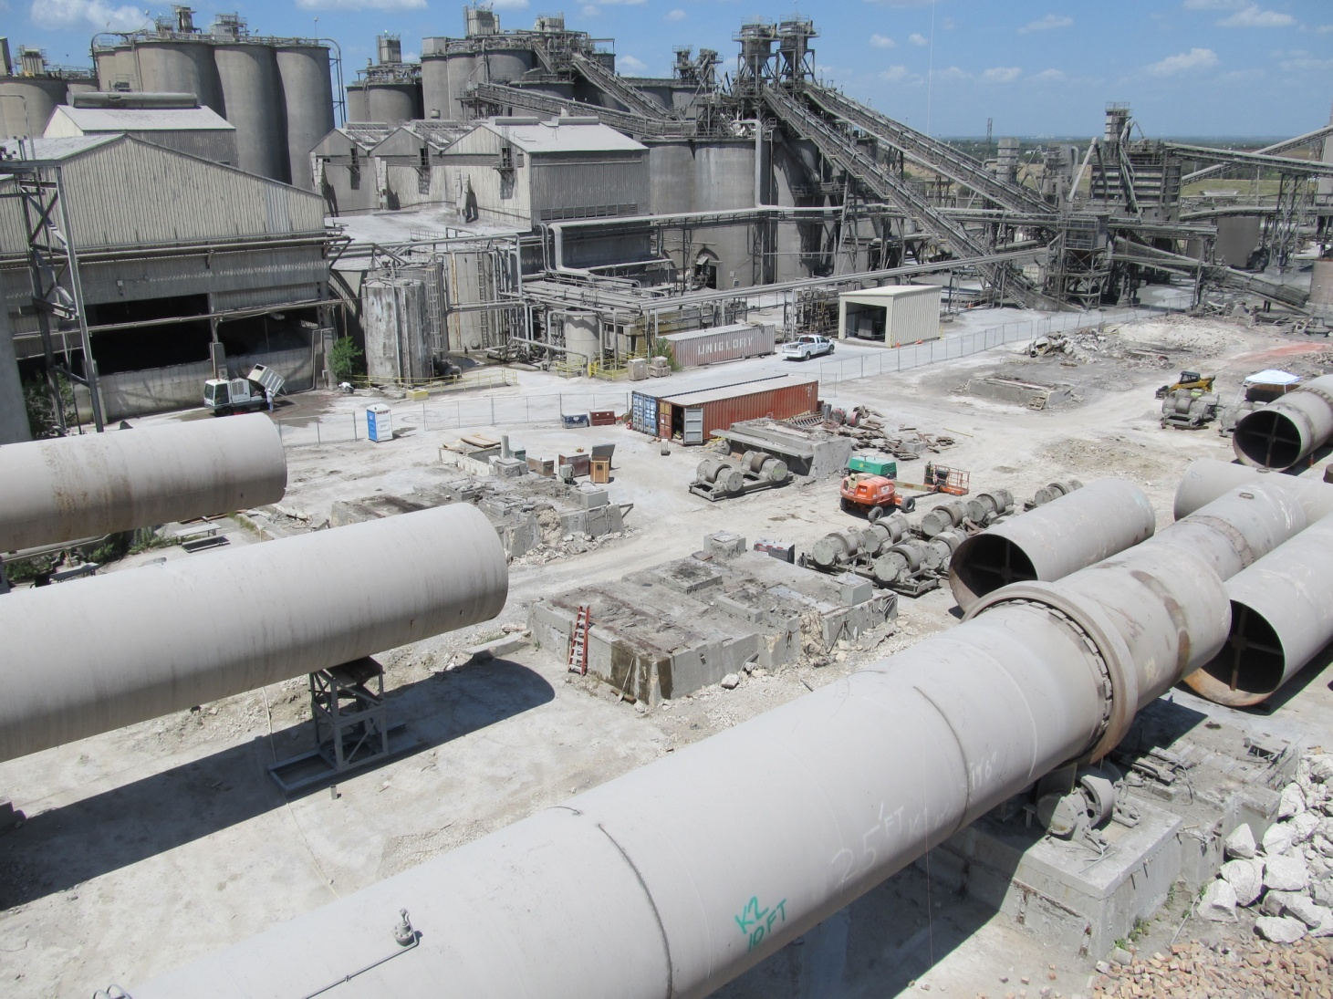
KILN REMOVAL – SYNERGY
(Midlothian, Texas)
Kiln Removal – Midlothian, Texas (@ TXI’s cement plant)

Slide 7
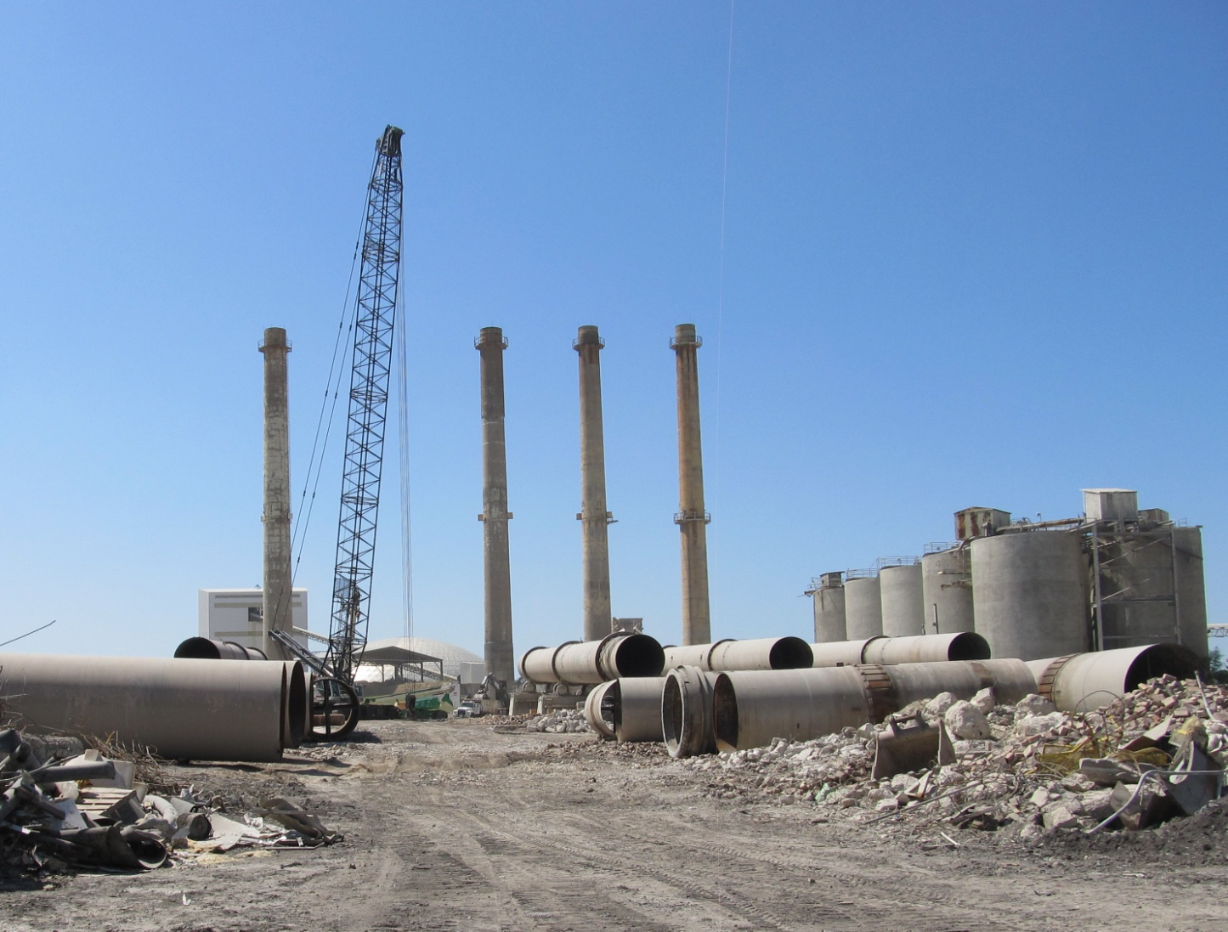
KILN REMOVAL – SYNERGY
(Midlothian, Texas)
Kiln Removal – Midlothian, Texas (@ TXI’s cement plant)

Slide 8
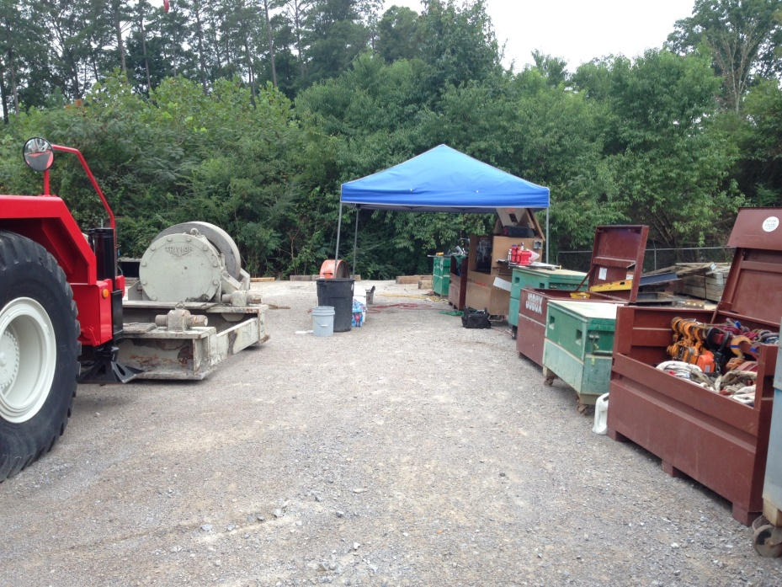
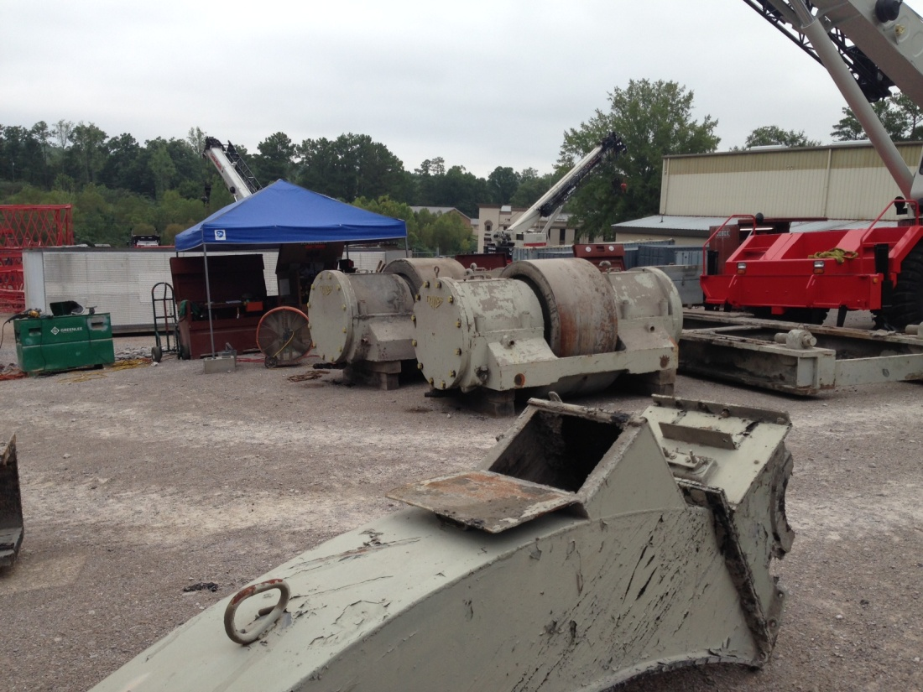
KILN REMOVAL – SYNERGY
(Midlothian, Texas)
Part Reconditioning – Birmingham, Alabama

Slide 9
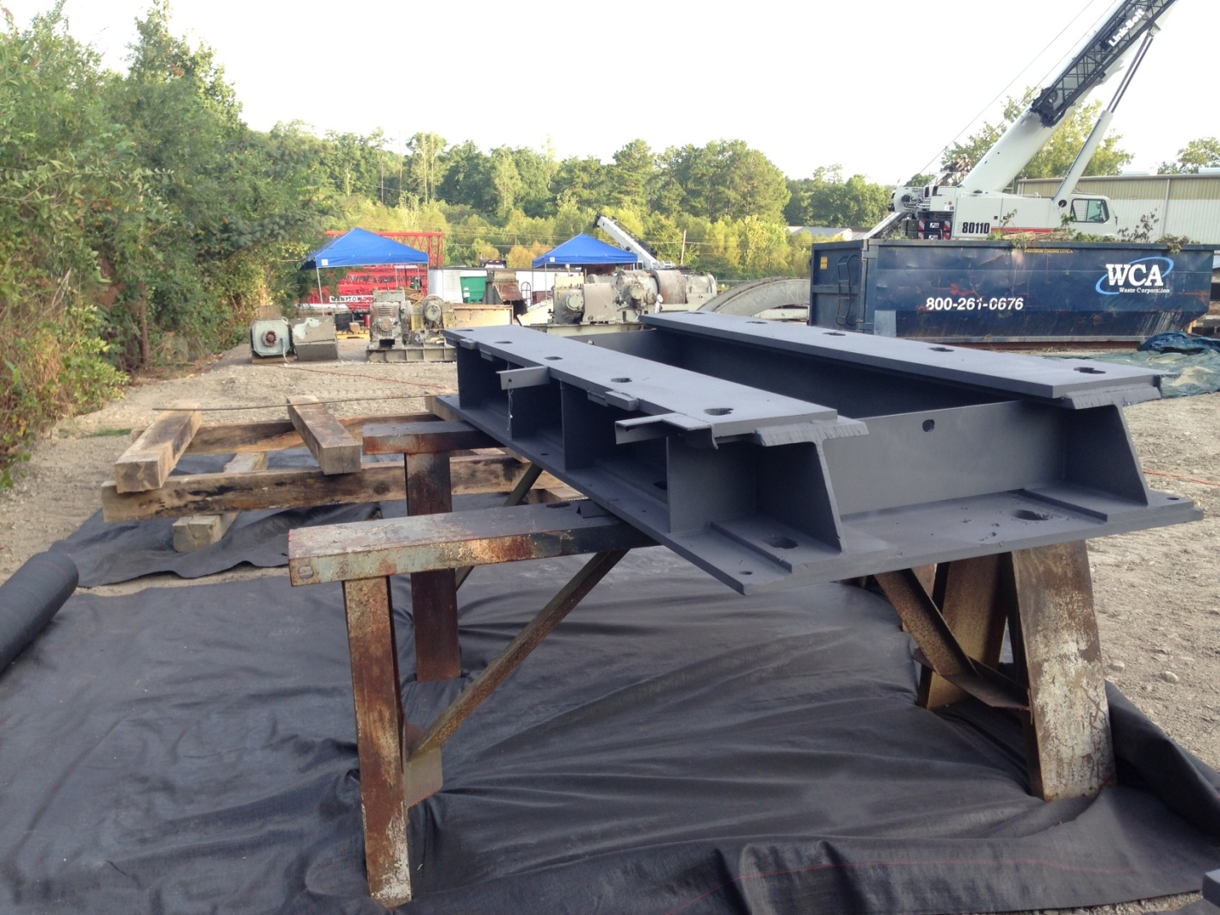
KILN REMOVAL – SYNERGY
(Midlothian, Texas)
Part Reconditioning – Birmingham, Alabama

